Slide 1
LMAX MultiCharts Training Manual
VERSION 1 | DATE 01 November 2011
LMAX Internal

Slide 2
GENERAL INFORMATION

Slide 3
Client Information
A client can request LMAX MultiCharts by sending an email to software@lmax.com. It is free of charge until the end of the year. Starting from 1 Jan 2012, if the client is willing to continue using the software for free, they have to have $5,000 in their account and make at least 250 trades a month; otherwise, they will be charged $60 per month for further usage of the platform.

Slide 4
GETTING STARTED

Slide 5
Getting started
Download LMAX Multicharts from the following link: http://static.lmaxtrader.com/downloads/MultiCharts-LMAX.exe.
After downloading Multicharts and opening it, log in using your account username and password (in order to use a Demo version, change the Connection to ‘Demo’).
The following is what should be seen on the opening of Multicharts for the first time:
Three workspaces – FX (EUR/USD, GBP/USD, USD/JPY, EUR/GBP), Indices (UK 100, Wall Street 30, US SPX 500, Germany 30), and Commodities (Gold, Brent Crude, Silver, Copper).
Depth of market (or Ladder) on the left hand side.
Account information at the bottom of the window, which includes account summary (balance, margin, P/L), orders history, positions currently open and activity log.
Toolbar at the top of the window together with LMAX trade area just below it.

Slide 6
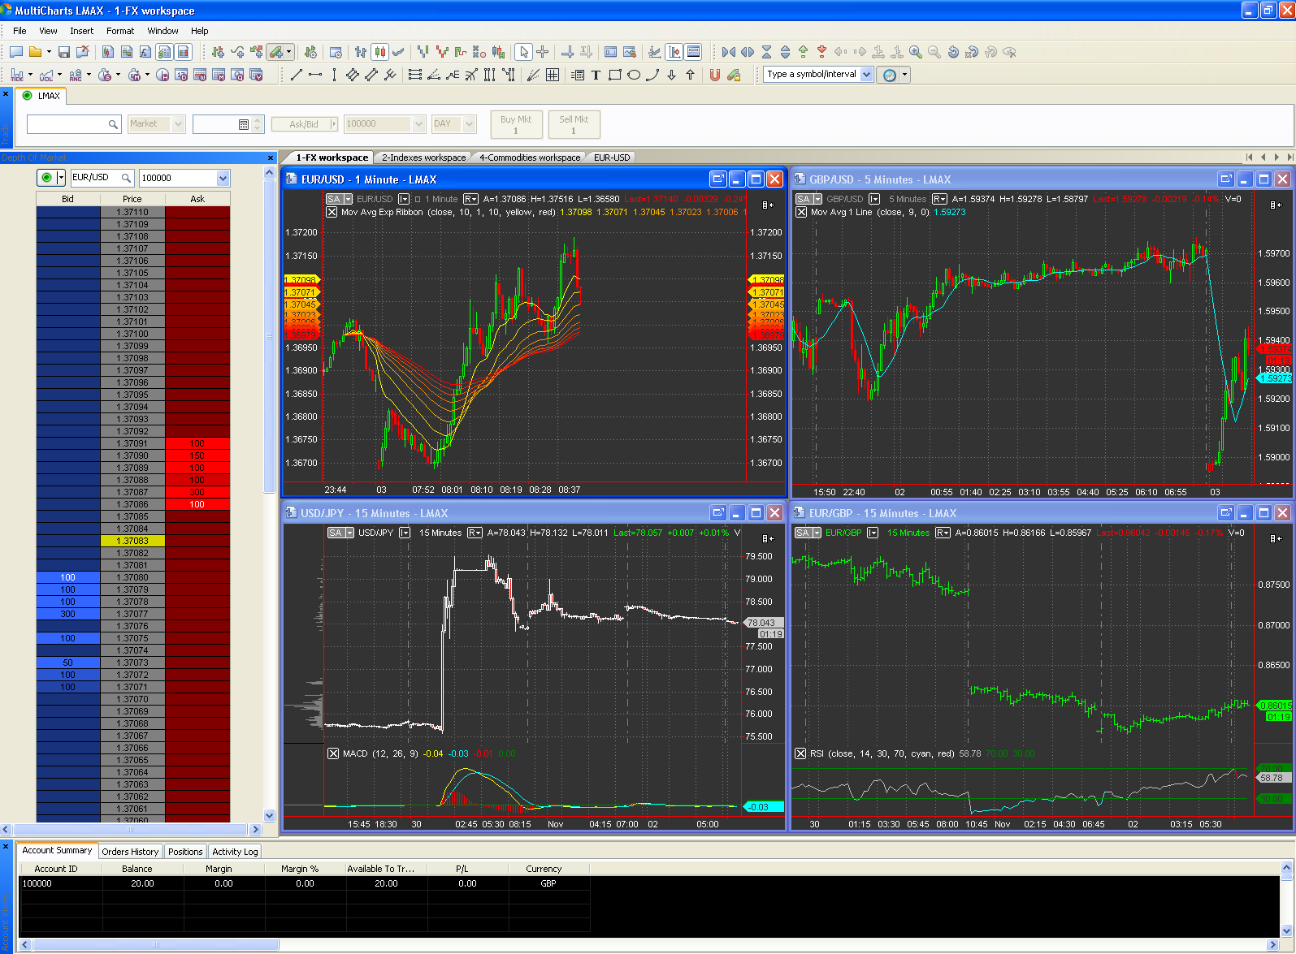

Slide 7
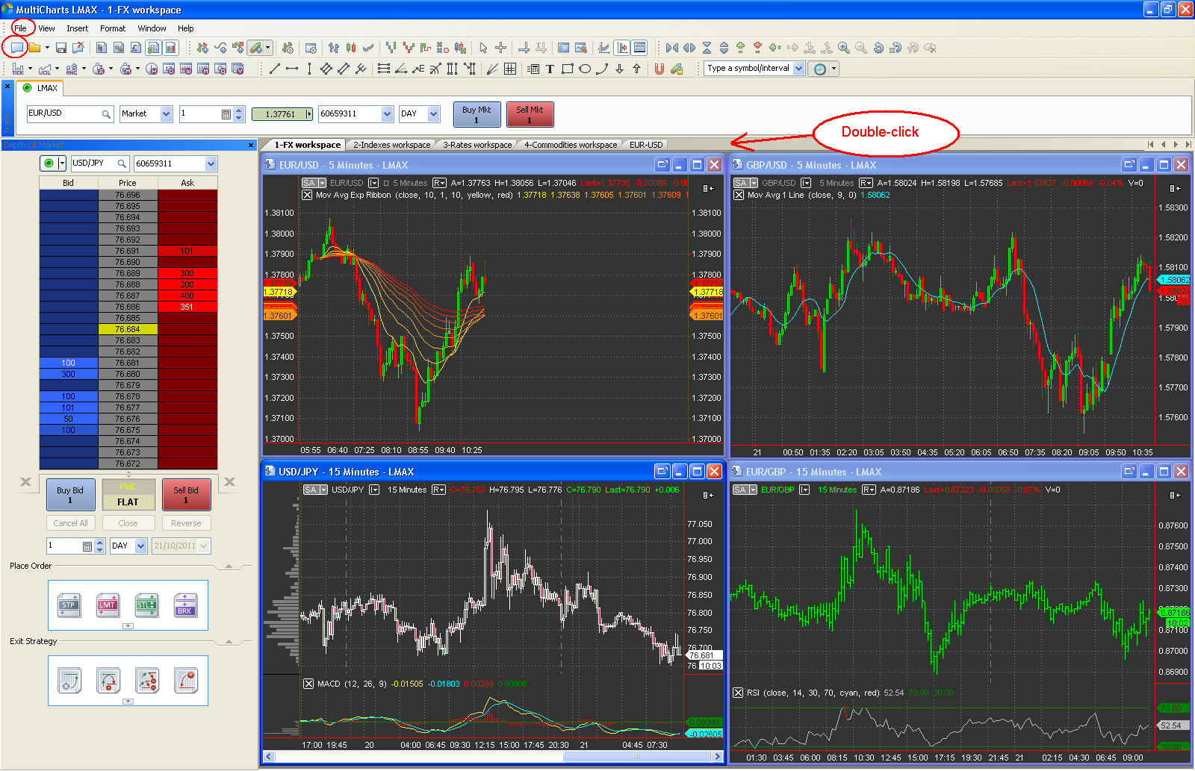
Personalisation
Creating a Workspace
To create new workspace either double-click on the area of workspace tabs, or choose File -> New -> Workspace (Ctrl+N). Alternatively, click on a ‘Create New Workspace’ icon on the toolbar. Rename, save or close a workspace by right-clicking on the tab of the workspace.

Slide 8
Personalisation
Creating Charts
To create a new chart within the workspace, either right-click on an empty area of the workspace and choose ‘Chart Window’, or click File -> New -> Chart Window (Ins), or click on a ‘Create New Chart Window’ icon on the toolbar.

Slide 9
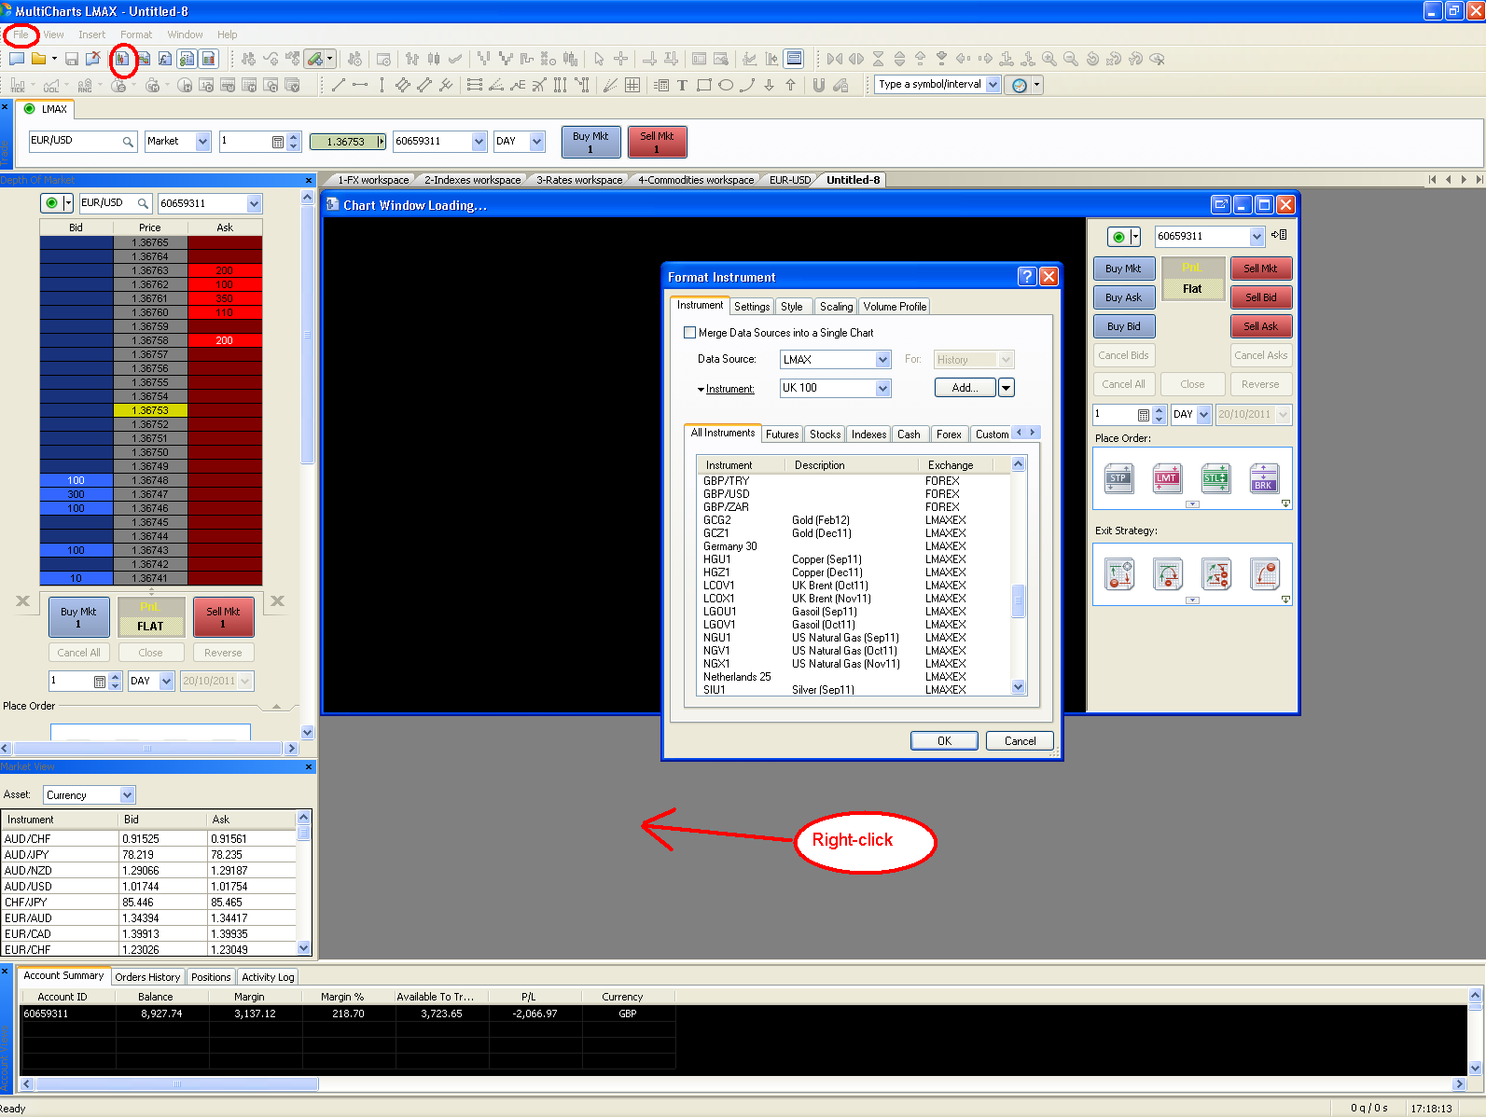

Slide 10
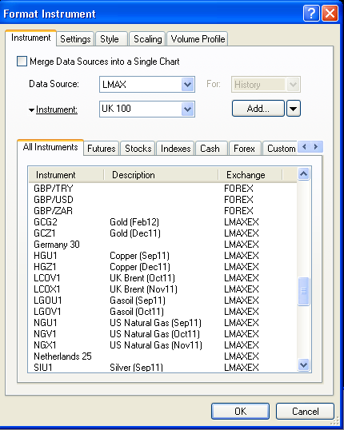
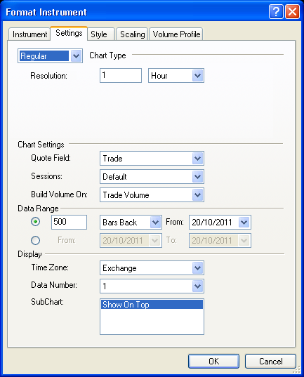
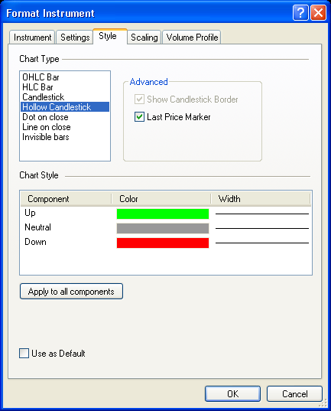
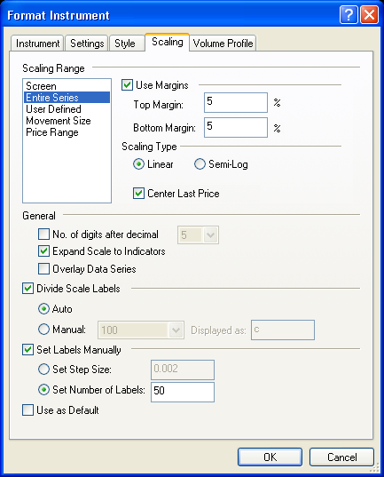
Personalisation
After the ‘Format Instrument’ window pops out, the following can be found under these tabs:
Instrument: choose an instrument to be displayed in the chart (another instrument can later be added the same chart)
Settings: set a resolution (e.g., every 5 minutes), quote type (e.g., bid), data range, sub chart (the area on the chart where the instrument is going to be displayed), and other.
Style: choose the style of the graph (e.g., line or candlestick), and colours.
Scaling: set the scaling and layout of the chart.
Volume Profile: format the Volume chart.

Slide 11
Personalisation
Changing Charts
To go back to the ‘Format Instrument’ window, either right-click on the empty area of the chart and choose ‘Format Instrument’, or click Format -> Instrument, or choose ‘Format Instrument’ icon on the toolbar.
In order to change any of the chart window settings, right-click on an empty area of the chart and choose ‘Format Window’, or alternatively, choose Format -> Window.
To zoom in, click on the ‘Zoom In’ icon on the toolbar, or choose Format -> Zoom In, and then select the area on the chart to be enlarged. The same actions are required when wanting to zoom out, except there is no need to select an area anymore, it will automatically come back to the previous view.
There are options to detach, reattach, and move around the chart windows outside their workspace. Choose Window -> Detach Window (Ctrl+Alt+D), or click on ‘Detach Window’ icon on the top right corner of the window. After, there are options to choose to ‘Stick’ the window, so it stays on top of the workspace, or ‘Attach Window’ back to its place on the workspace.

Slide 12
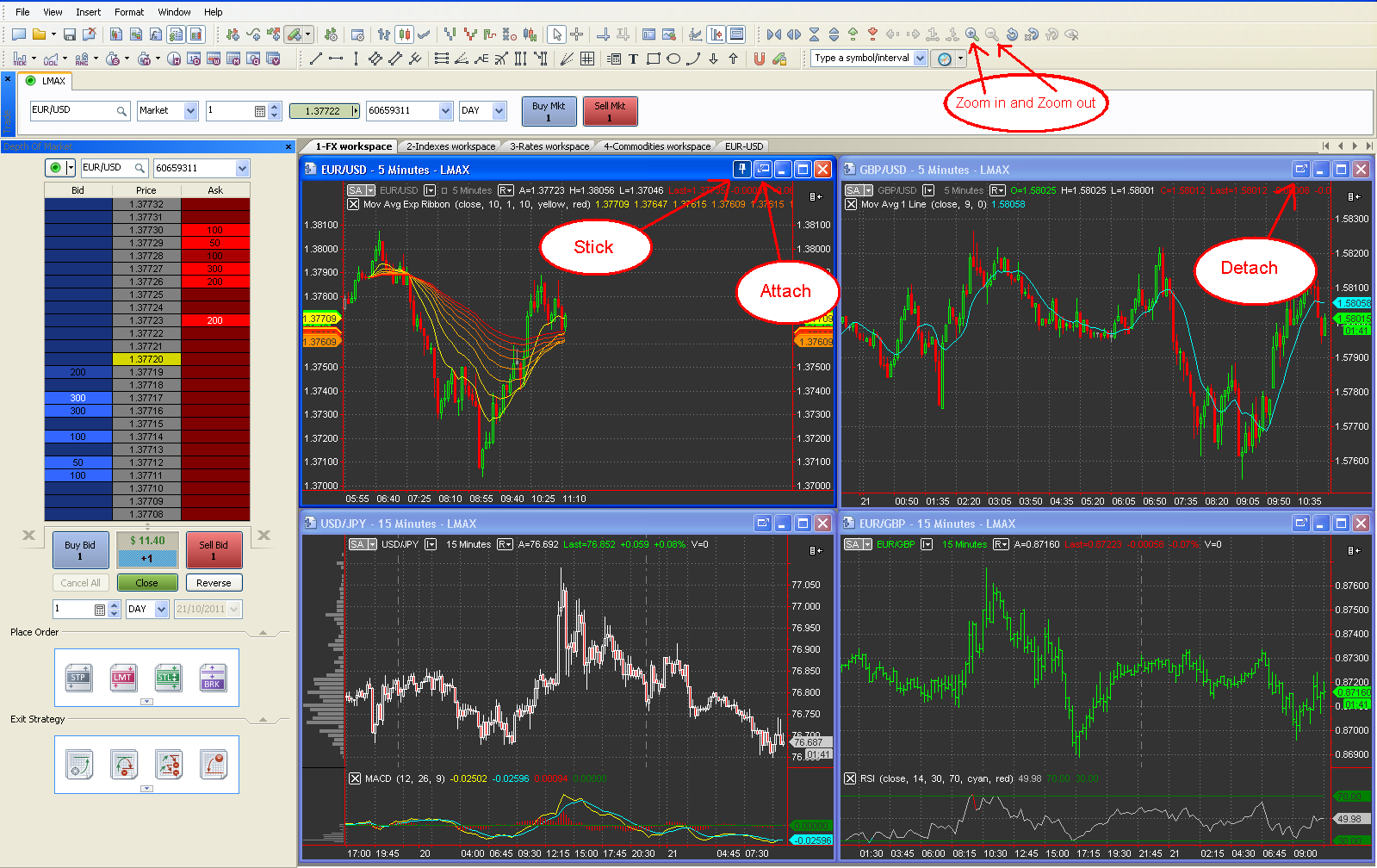

Slide 13
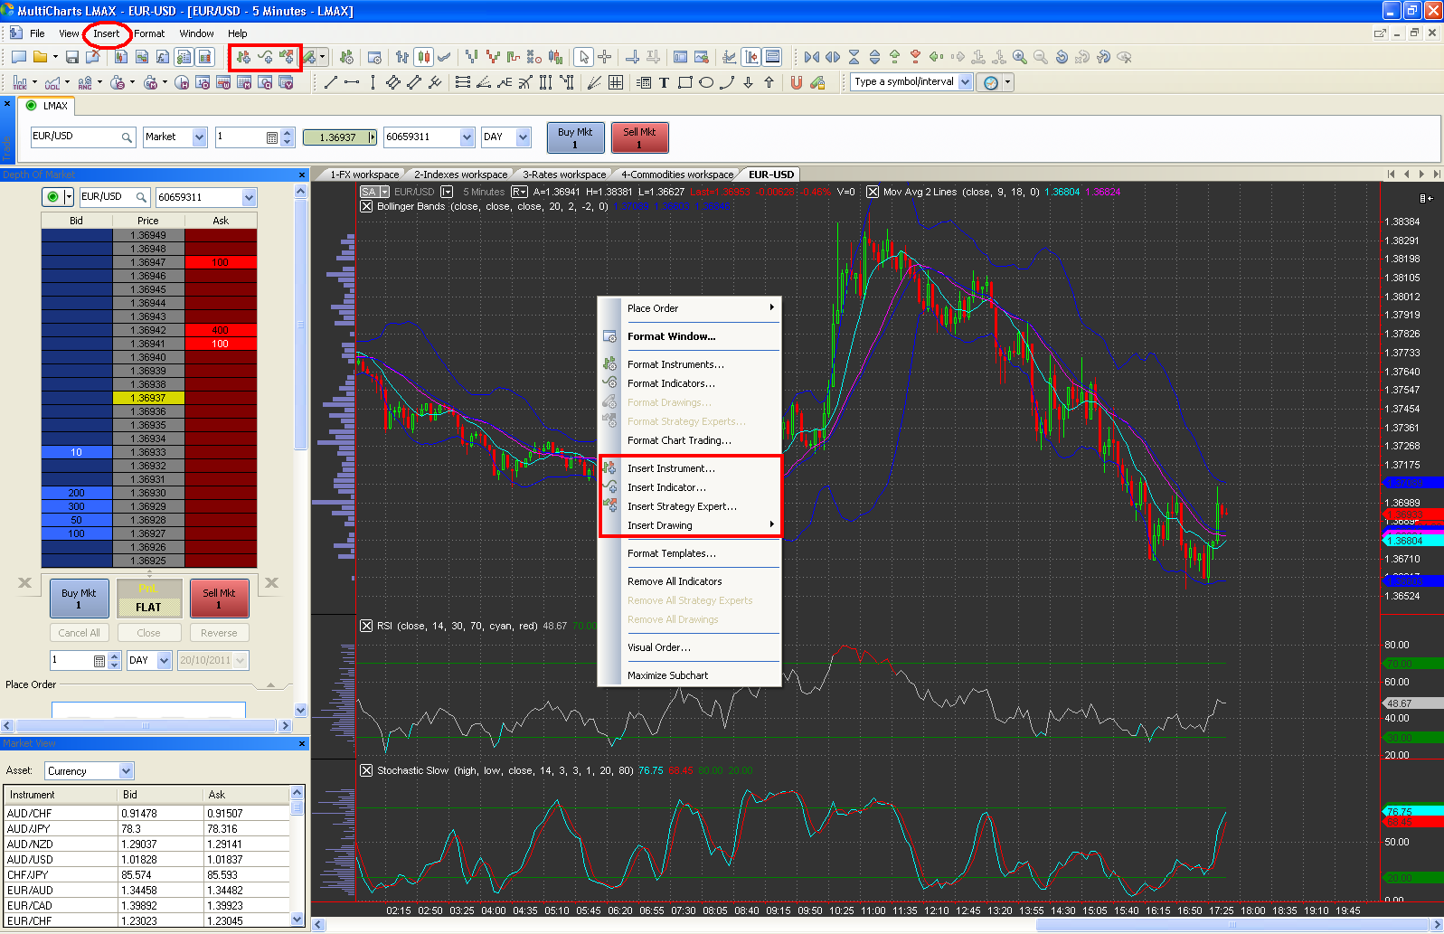
Personalisation
Adding Features
Different features can be added to the chart by choosing Insert -> Instrument/ Indicator/ Drawing/ Strategy Expert, or right-clicking on an empty area of the chart window and choosing ‘Insert Instrument’, ‘Insert Indicator’, ‘Insert Strategy Expert’, or ‘Insert Drawing’. Alternatively, choose from a variety of icons on the toolbar to insert a drawing.

Slide 14
TRADING

Slide 15
Trading
Placing a Trade
Placing a trade is easy and can be done in several ways:
At the top of the window, just below the toolbar area, choose an instrument, type of order, number of contracts, and click BUY or SELL.
Trade the same way as the above from the area on the left-hand side (it might need to be extended in order to see all of the options available), or trade directly from the ladder by clicking on the blue-Bid or red-Ask area at the chosen price.
On the chart window, press on a ladder-arrow icon in the top right corner, and place a trade from the window that slides out. Not only the type of order can be chosen but also an exit strategy, such as Profit Target or Stop Loss.
Right-click on an empty area of the chart window and choose ‘Place Order’.
Exit Options
Alternatively to choosing an exit option when placing a trade, it can also be chosen after the trade is placed. Right-click on the position window (which shows the number of contracts and current P/L), click ‘Attach Exit Strategy’ and choose from ‘Profit Target’, ‘Breakeven’, ‘Trailing Stop’, ‘Stop Loss’, ‘Master Strategy’, and ‘Brackets’.

Slide 16
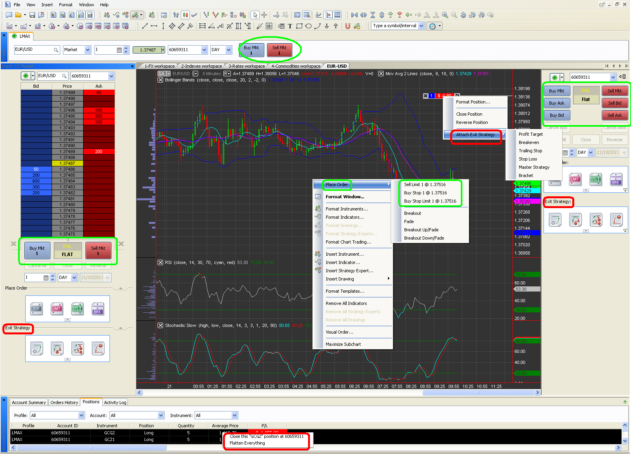

Slide 17
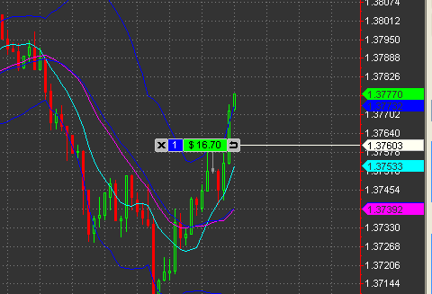
Trading
Closing Trades
Click on x icon on the position window to close the position or u-turn arrow to reverse the position. Also, at the bottom of the window in ‘Positions’ tab, right click on one of the trades open and choose from ‘Close this (current) position at (current price)’ or ‘Flatten Everything’.
Connection to LMAX UI
All trades placed on MultiCharts will be reflected on the LMAX UI. However, any exit strategies, such as Stop Loss, will not be seen on the UI until they are executed and they will then appear as Market Orders.
It is advisable not to use MultiCharts and UI side-by-side, as there might be some irregularities.

Slide 18
STRATEGY EXPERT

Slide 19
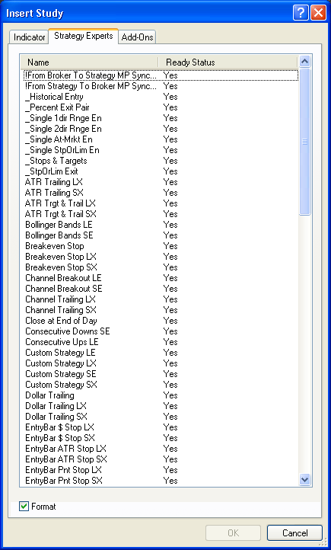
Strategy Expert
The following paragraphs will briefly explain where to find strategy experts (studies) and how to place them. It is, however, beyond the scope of this document to explain how to create the strategies or how they work.
Strategies can be added in several ways. One of them is by choosing Insert -> Strategy Expert, or right-clicking on an empty area of the chart window and choosing ‘Insert Strategy Expert’. Alternatively, choose ‘Insert Strategy Expert’ icon on the toolbar. When an ‘Insert Study’ window pops out, choose a relevant strategy from the default list.

Slide 20
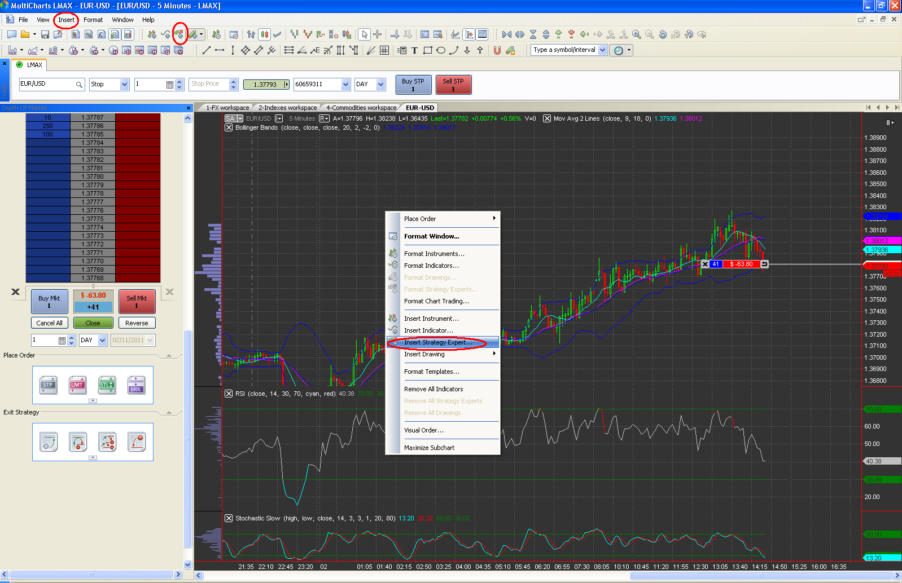

Slide 21
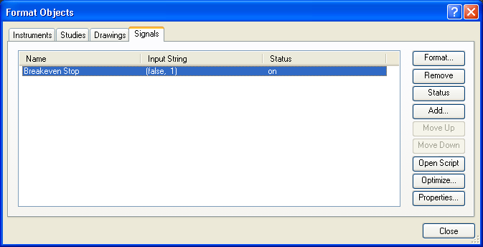
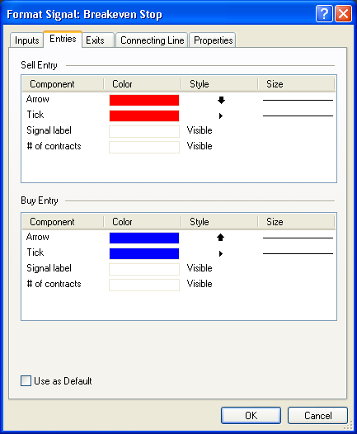
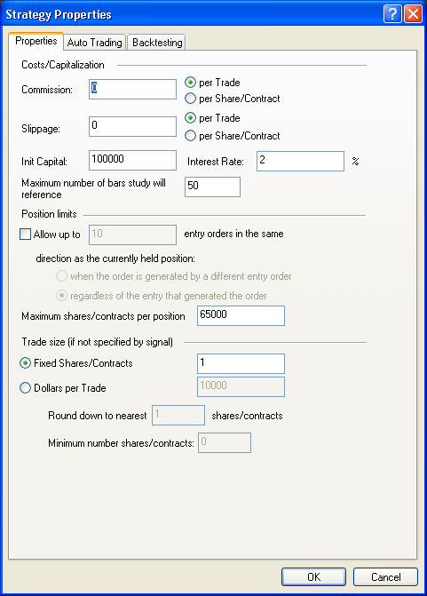
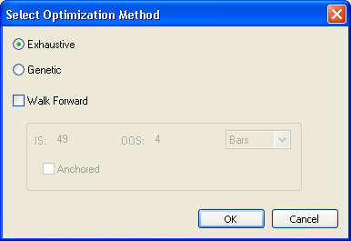
Strategy Expert
In the ‘Format Object’ window, which is shown after the strategy is chosen, the following options are available:
‘Format’ – allows formatting the features of the strategy
‘Properties’ – allows changing the ‘Properties’ (such as commission, interest rate, etc), ‘Auto Trading’ (automated order execution settings and other), and ‘Backtesting’ (which includes backtesting modes, precision, and assumptions).
‘Optimize’ – allows to select a way in which the strategy will be optimized.
Other options include ‘Remove’, ‘Status’, ‘Add’, and ‘Open Script’.
Source:
Note:

Slide 22
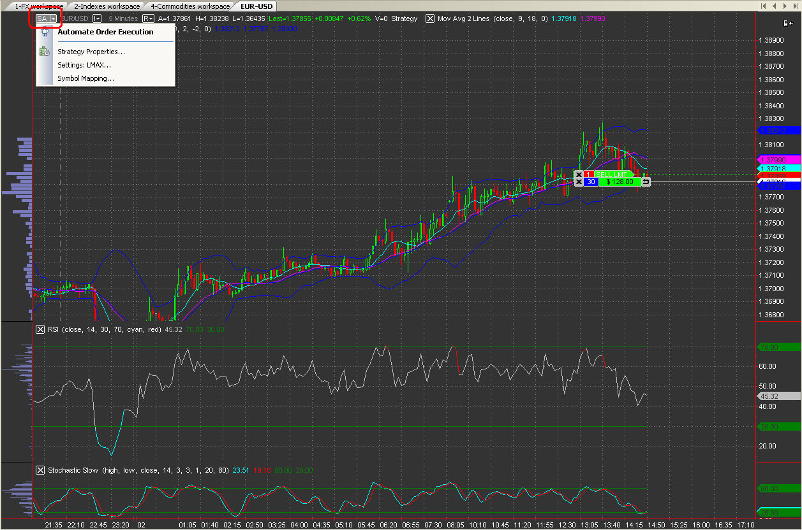
Strategy Expert
In order to run the strategy, i.e. let it place trades, select ‘SA’ icon at the top left corner of the chart and press ‘Automate Order Execution’.
Source:
Note:

Slide 23
FURTHER INFORMATION

Slide 24
Further Information
MultiCharts Help file (F1) is a great tool for getting more in depth understanding of the platform, including further explanation of all the indicators, drawings and strategy expert (studies). Furthermore, some additional information can be found in forums and FAQs on MultiCharts website at http://www.multicharts.com/.

